Slide 1
Data Mining: Exploring Data
Lecture Notes for Chapter 3
Introduction to Data Mining
by
Tan, Steinbach, Kumar

Slide 2
What is data exploration?
A preliminary exploration of the data to better understand its characteristics.
Key motivations of data exploration include
Helping to select the right tool for preprocessing or analysis
Making use of humans’ abilities to recognize patterns
People can recognize patterns not captured by data analysis tools
Related to the area of Exploratory Data Analysis (EDA)
Created by statistician John Tukey
Seminal book is Exploratory Data Analysis by Tukey
A nice online introduction can be found in Chapter 1 of the NIST Engineering Statistics Handbook
http://www.itl.nist.gov/div898/handbook/index.htm

Slide 3
What is data exploration?
A preliminary exploration of the data to better understand its characteristics.
Key motivations of data exploration include
Helping to select the right tool for preprocessing or analysis
Making use of humans’ abilities to recognize patterns
People can recognize patterns not captured by data analysis tools
Related to the area of Exploratory Data Analysis (EDA)
Created by statistician John Tukey
Seminal book is Exploratory Data Analysis by Tukey
A nice online introduction can be found in Chapter 1 of the NIST Engineering Statistics Handbook
http://www.itl.nist.gov/div898/handbook/index.htm

Slide 4
Techniques Used In Data Exploration
In EDA, as originally defined by Tukey, the focus was on visualization
maximize insight into a data set; Let the data speak for itself!
uncover underlying structure;
extract important variables;
detect outliers and anomalies;
test underlying assumptions;
develop parsimonious models; and
determine optimal factor settings.
In our discussion of data exploration, we focus on
Summary statistics
Visualization
Online Analytical Processing (OLAP)

Slide 5
Before We Continue: The Data Miner’s Dilemma
What programming language to use & why?
Productivity
High-
Scripting
(R, MATLAB, IDL)
Level
Languages
Object Oriented
(C++, Java)
Functional languages
(C, Fortran)
Performance
Low-Level Languages
Assembly

Slide 6
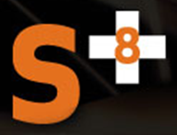

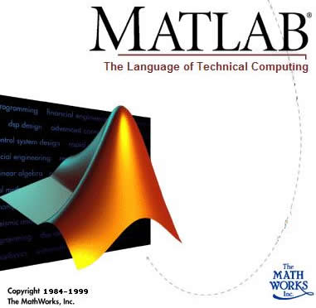


Why R?
Statistics & Data Mining
Commercial
Technical computing
Matrix and vector formulations
Statistical computing and graphics
http://www.r-project.org
Data Visualization and analysis platform
Image processing, vector computing
Developed by R. Gentleman & R. Ihaka
Expanded by community as open source
Statistically rich
6

Slide 7
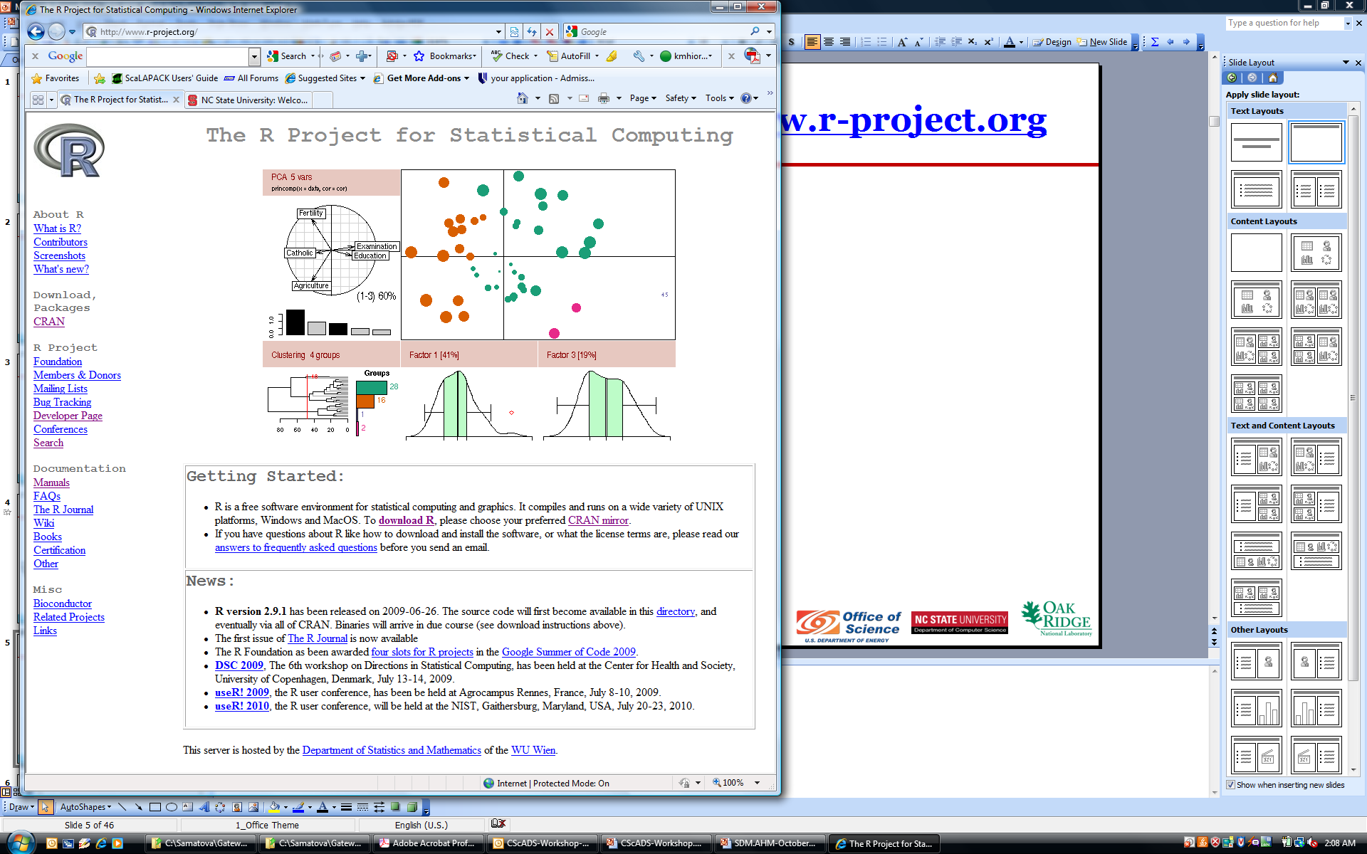
Statistical Computing with R – http://www.r-project.org
Open source, most widely used for statistical analysis and graphics
Extensible via dynamically loadable add-on packages
>1,800 packages on CRAN
> v = rnorm(256)
> A = as.matrix (v,16,16)
> summary(A)
> library (fields)
> image.plot (A)

Slide 8
Useful R Links
R Home: http://www.r-project.org/
R’s CRAN package distribution: http://cran.cnr.berkeley.edu/
Introduction to R manual: http://cran.cnr.berkeley.edu/doc/manuals/R-intro.pdf
Writing R extensions: http://cran.cnr.berkeley.edu/doc/manuals/R-exts.pdf
Other R documentation: http://cran.cnr.berkeley.edu/manuals.html

Slide 9
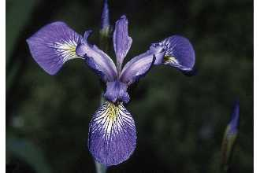
Iris Sample Data Set
Many of the exploratory data techniques are illustrated with the Iris Plant data set.
Can be obtained from the UCI Machine Learning Repository http://www.ics.uci.edu/~mlearn/MLRepository.html
From the statistician Douglas Fisher
Three flower types (classes):
Setosa
Virginica
Versicolour
Four (non-class) attributes
Sepal width and length
Petal width and length
Virginica. Robert H. Mohlenbrock. USDA NRCS. 1995. Northeast wetland flora: Field office guide to plant species. Northeast National Technical Center, Chester, PA. Courtesy of USDA NRCS Wetland Science Institute.

Slide 10
Summary Statistics
Summary statistics are numbers that summarize properties of the data
Summarized properties include frequency, location and spread
Examples: location - mean spread - standard deviation
Most summary statistics can be calculated in a single pass through the data

Slide 11
Frequency and Mode
The frequency of an attribute value is the percentage of time the value occurs in the data set
For example, given the attribute ‘gender’ and a representative population of people, the gender ‘female’ occurs about 50% of the time.
The mode of a an attribute is the most frequent attribute value
The notions of frequency and mode are typically used with categorical data

Slide 12
Percentiles
For continuous data, the notion of a percentile is more useful.
Given an ordinal or continuous attribute x and a number p between 0 and 100, the pth percentile is a value of x such that p% of the observed values of x are less than .
For instance, the 50th percentile is the value such that 50% of all values of x are less than .

Slide 13
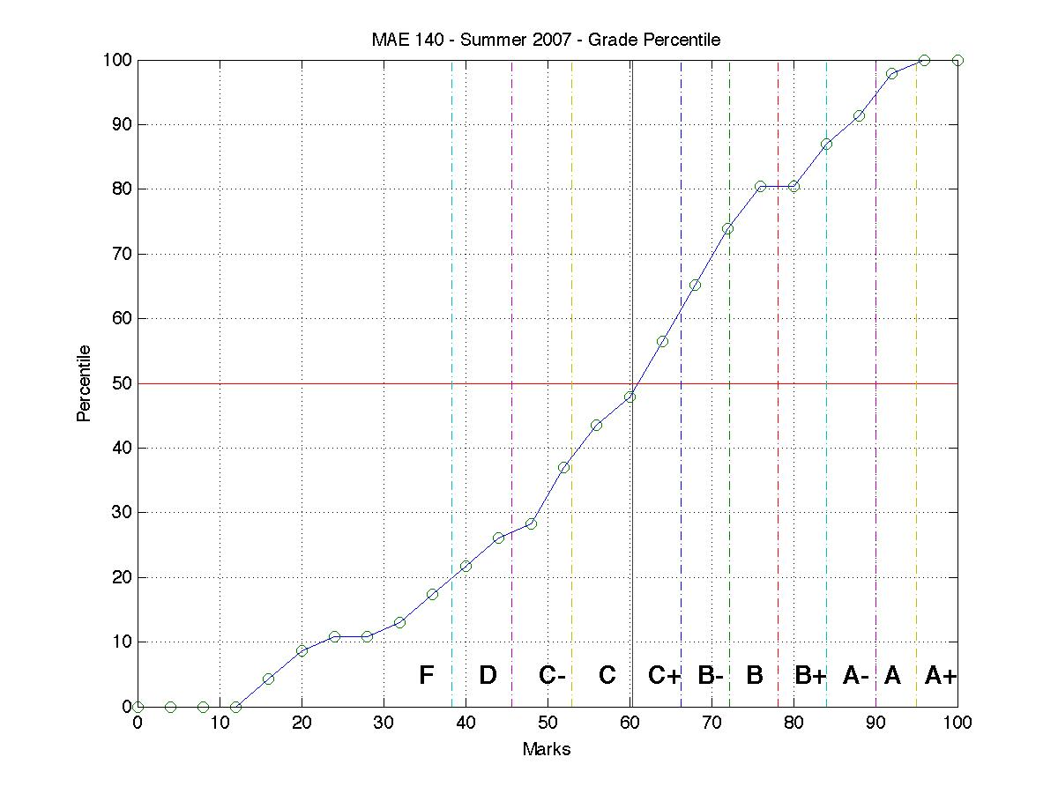
Percentile Plots

Slide 14
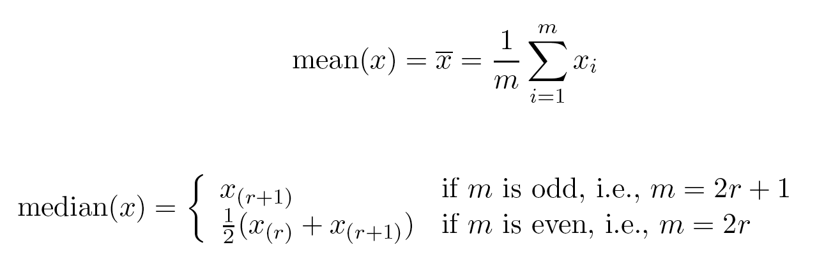
Measures of Location
Mean
Weighted arithmetic mean
Median
Summary of frequency distribution
Middle value if odd number of values, or average of the middle two values otherwise
Mode
Value that occurs most frequently in the data
Peaks in frequency distribution: unimodal, bimodal, trimodal

Slide 15
Measures of Spread
Range: max - min
Variance s²
Standard deviation s
The square root of the variance
Measures spread about the mean
It is zero if and only if all the values are equal

Slide 16

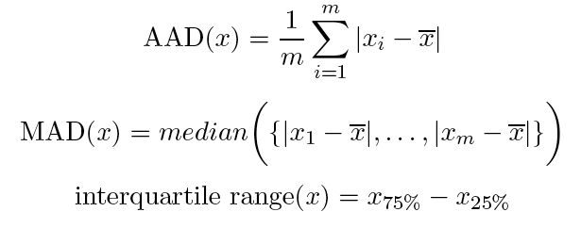
More Robust Measures of Spread
Absolute Average Deviation (AAD)
Median absolute deviation (MAD)
Median of distances from mean
Interquartile Range (IQR)

Slide 17
Visualization
Visualization is the conversion of data into a visual or tabular format so that the characteristics of the data and the relationships among data items or attributes can be analyzed or reported.
Visualization of data is one of the most powerful and appealing techniques for data exploration.
Humans have a well developed ability to analyze large amounts of information that is presented visually
Can detect general patterns and trends
Can detect outliers and unusual patterns

Slide 18
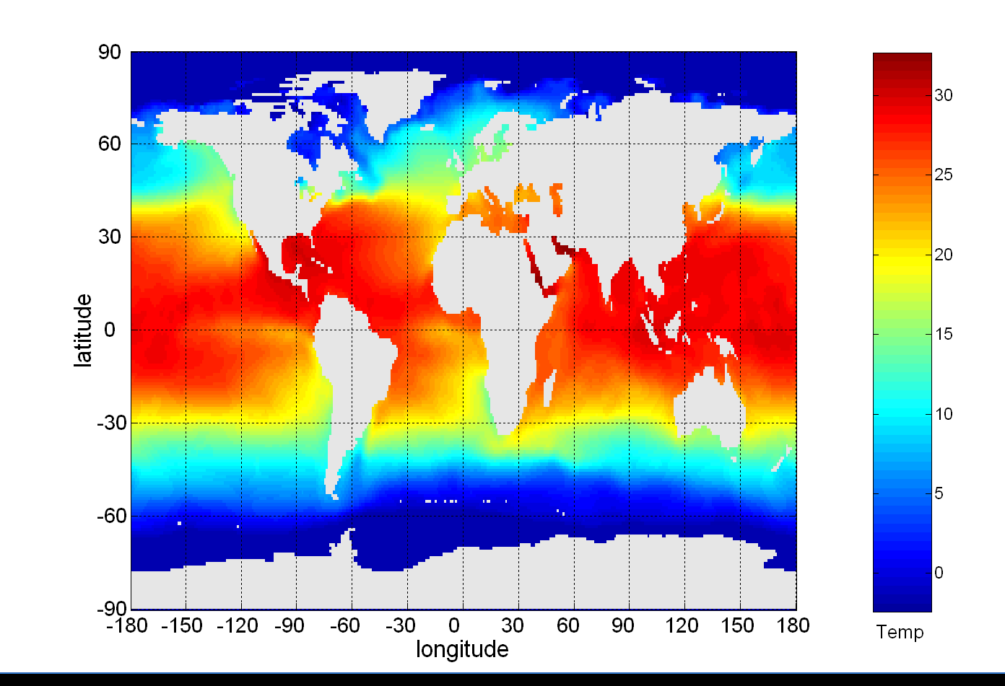
Example: Sea Surface Temperature
The following shows the Sea Surface Temperature (SST) for July 1982
Tens of thousands of data points are summarized in a single figure

Slide 19
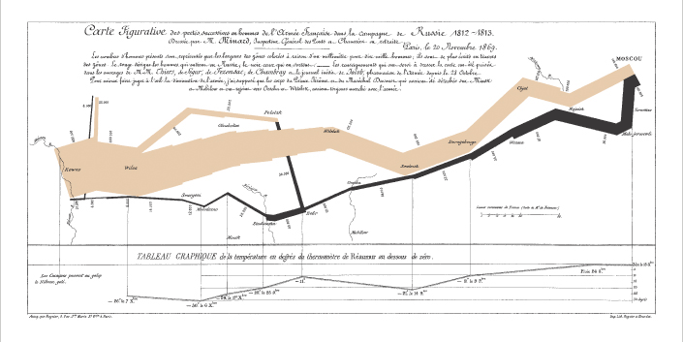
Napoleon’s March to Moscow (1812)
Probably the best statistical graphic ever drawn, this map by Charles Joseph Minard portrays the losses suffered by Napoleon's army in the Russian campaign of 1812. Beginning at the Polish-Russian border, the thick band shows the size of the army at each position. The path of Napoleon's retreat from Moscow in the bitterly cold winter is depicted by the dark lower band, which is tied to temperature and time scales.

Slide 20
Representation
Is the mapping of information to a visual format
Data objects, their attributes, and the relationships among data objects are translated into graphical elements such as points, lines, shapes, and colors.
Example:
Objects are often represented as points
Their attribute values can be represented as the position of the points or the characteristics of the points, e.g., color, size, and shape
If position is used, then the relationships of points, i.e., whether they form groups or a point is an outlier, is easily perceived.

Slide 21
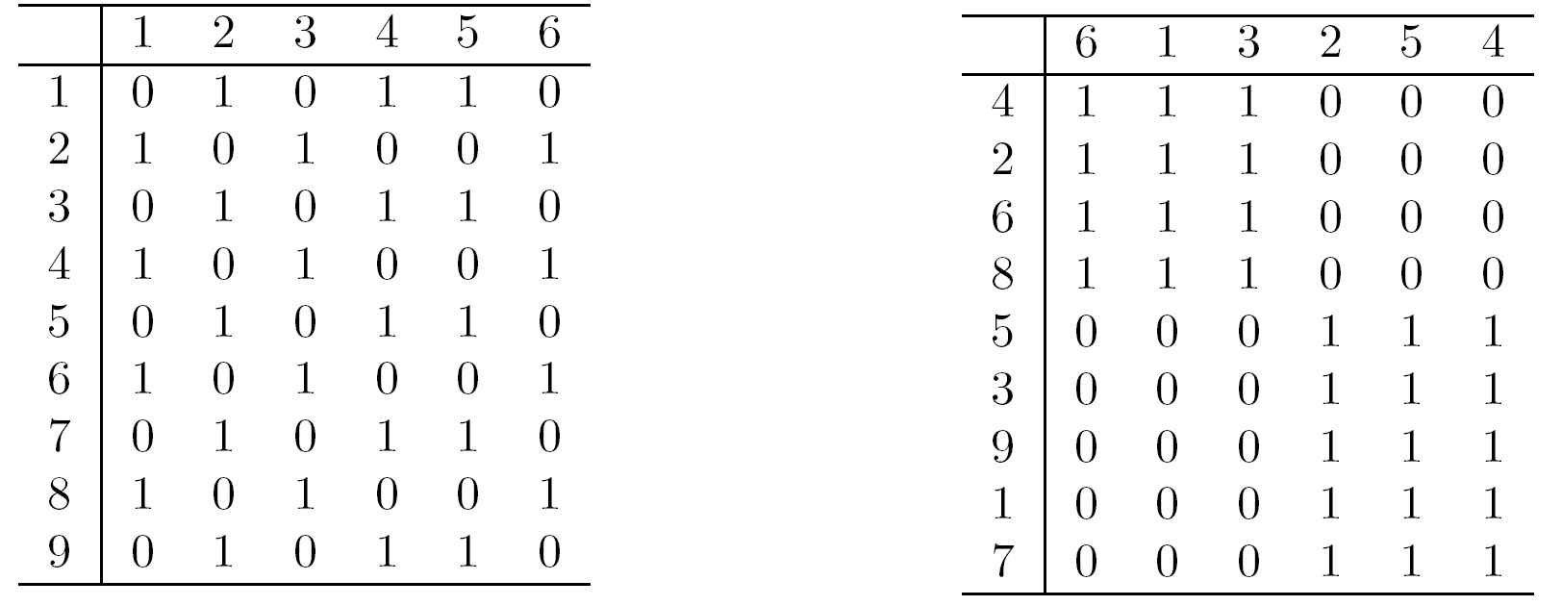
Arrangement
Is the placement of visual elements within a display
Can make a large difference in how easy it is to understand the data
Example:

Slide 22
Selection
Is the elimination or the de-emphasis of certain objects and attributes
Selection may involve the chossing a subset of attributes
Dimensionality reduction is often used to reduce the number of dimensions to two or three
Alternatively, pairs of attributes can be considered
Selection may also involve choosing a subset of objects
A region of the screen can only show so many points
Can sample, but want to preserve points in sparse areas

Slide 23
Visualization Techniques
Visualizing dispersion
Histograms
Percentile plots
Box plots
Scatter plots
Density surface and gradient plots
Animation
Iconic representation
Parallel Coordinates

Slide 24
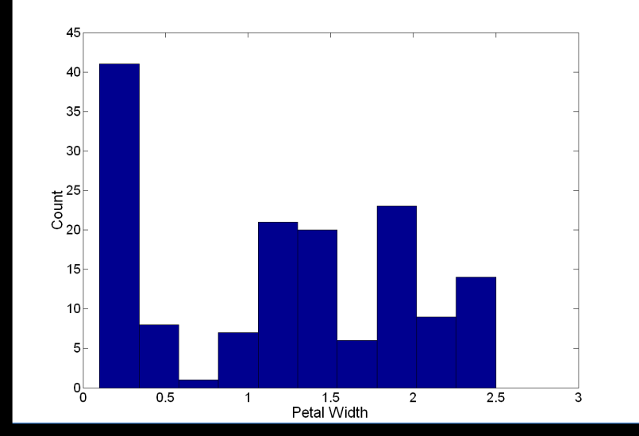
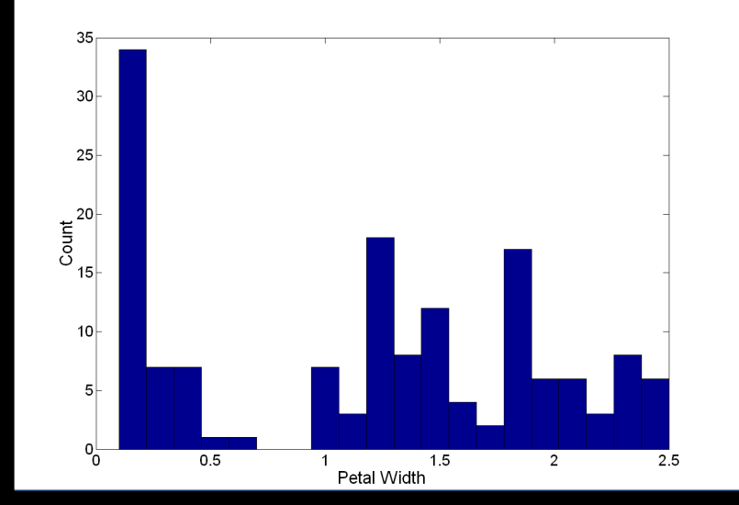
Visualization Techniques: Histograms Analysis
Histogram
Usually shows the distribution of values of a single variable
Divide the values into bins and show a bar plot of the number of objects in each bin.
The height of each bar indicates the number of objects
Shape of histogram depends on the number of bins
Example: Petal Width (10 and 20 bins, respectively)

Slide 25
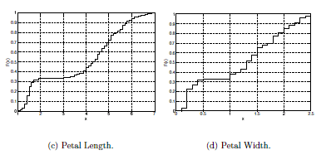
Percentile plots
Plot cumulative distribution information to display both the overall behavior and unusual occurrences
Sort data by increasing values
Percentile fraction f_{i} indicates that approximately (100 f_{i})% of the data have values below or equal to the value x_{i}

Slide 26
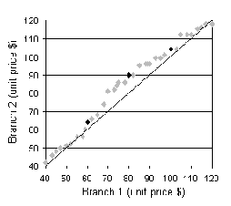
Percentile-percentile plot
Graphs the percentiles of one univariate distribution against the corresponding percentiles of another
Allows the user to view whether there is a shift in going from one distribution to another

Slide 27
Quartiles
Split percentiles into four parts
First through fourth quartiles
Inter-quartile range IQR
IQR = Q₃ – Q₁
Outliers
A subjective notion
Sometimes values distant from IQR by at least 1.5 x IQR
Sometimes values in top or bottom decile
Q4: 100th percentile
Q3: 75th percentile
Q2: 50th percentile
Q1: 25th percentile

Slide 28
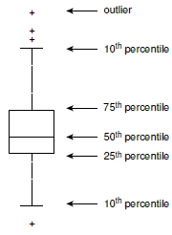
Box plots
Summarizing dispersion with five numbers
Min, Q1, Median, Q3, Max
Central box represents inter-quartile range (IRQ) between first and third quartiles
Box division represents median
Whiskers show expanse of max/min or outlier bounds
Outliers plotted as points

Slide 29
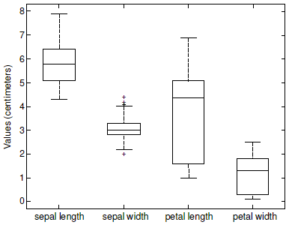
Iris data box plots

Slide 30
Visualization Techniques: Scatter Plots
Scatter plots
Attributes values determine the position
Two-dimensional scatter plots most common, but can have three-dimensional scatter plots
Often additional attributes can be displayed by using the size, shape, and color of the markers that represent the objects
It is useful to have arrays of scatter plots can compactly summarize the relationships of several pairs of attributes
See example on the next slide

Slide 31
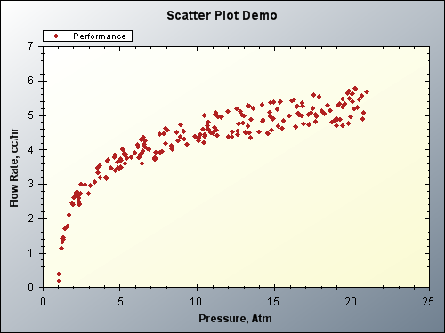
Scatter plots
Provide initial views of bivariate data to see clusters of points, outliers, etc
Each pair of values is treated as a pair of coordinates and plotted as points in the plane

Slide 32
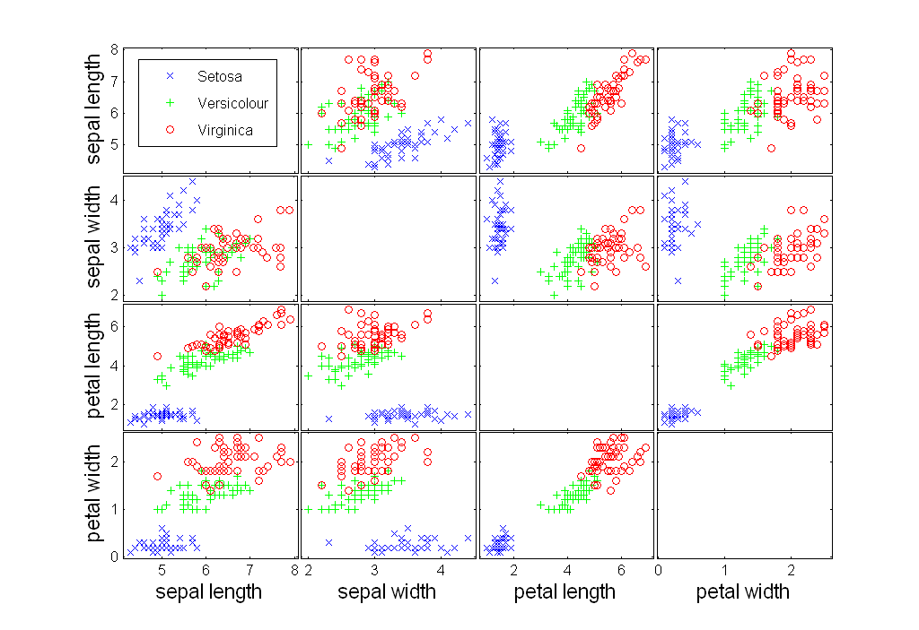
Scatter Plot Array of Iris Attributes

Slide 33
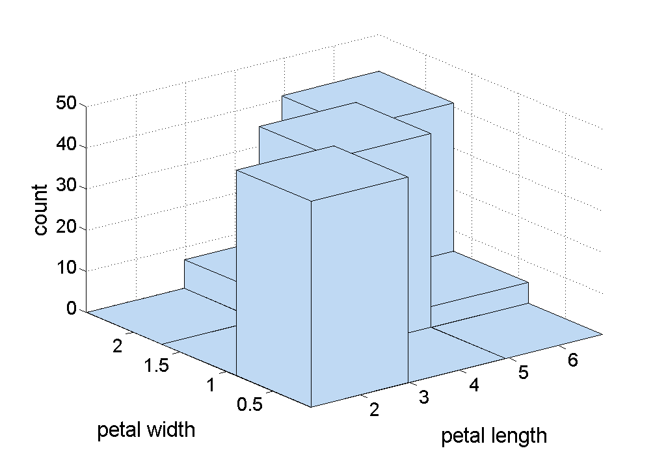
Two-Dimensional Histograms
Show the joint distribution of the values of two attributes
Example: petal width and petal length
What does this tell us?

Slide 34
Visualization Techniques: Contour Plots
Contour plots
Useful when a continuous attribute is measured on a spatial grid
They partition the plane into regions of similar values
The contour lines that form the boundaries of these regions connect points with equal values
The most common example is contour maps of elevation
Can also display temperature, rainfall, air pressure, etc.
An example for Sea Surface Temperature (SST) is provided on the next slide

Slide 35
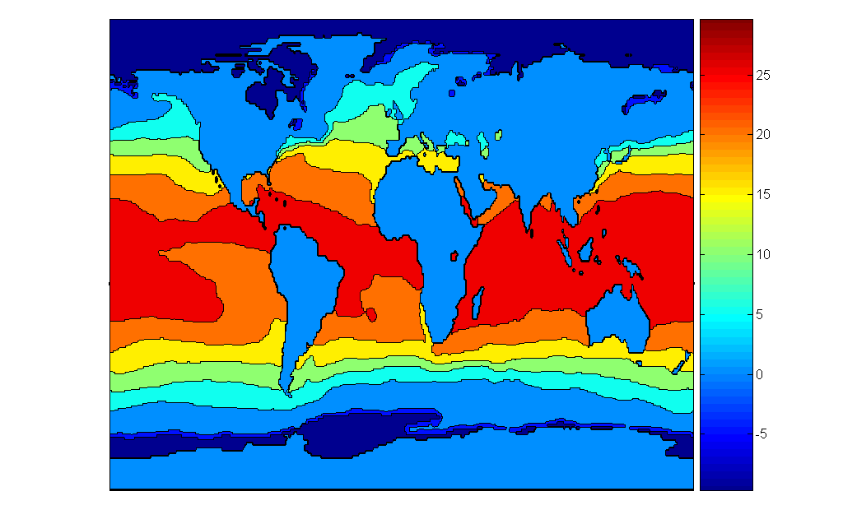
Contour Plot Example: SST Dec, 1998
Celsius

Slide 36
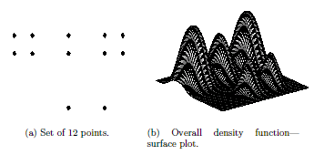
Density surface plots

Slide 37
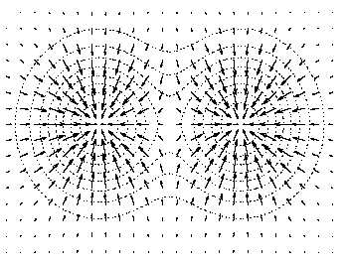
Density gradient plots

Slide 38
Visualization Techniques: Matrix Plots
Matrix plots
Can plot the data matrix
This can be useful when objects are sorted according to class
Typically, the attributes are normalized to prevent one attribute from dominating the plot
Plots of similarity or distance matrices can also be useful for visualizing the relationships between objects
Examples of matrix plots are presented on the next two slides

Slide 39
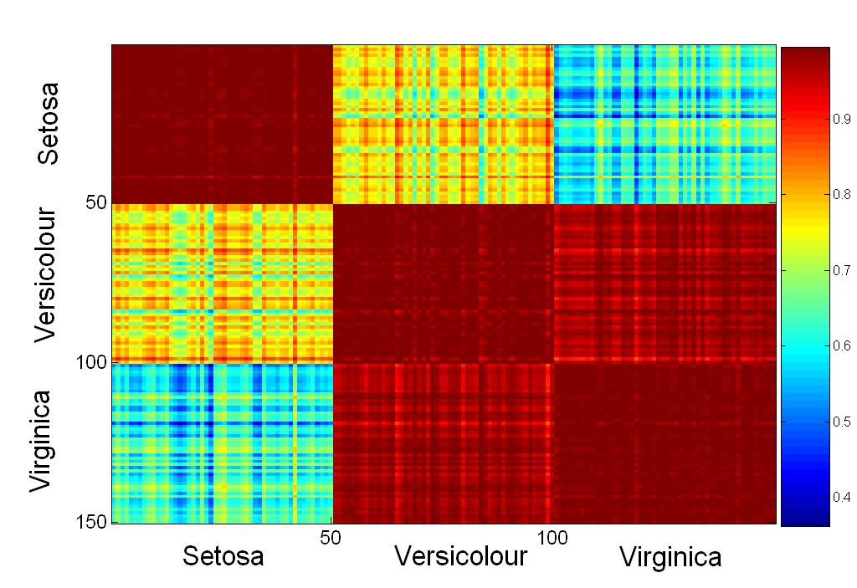
Visualization of the Iris Correlation Matrix

Slide 40
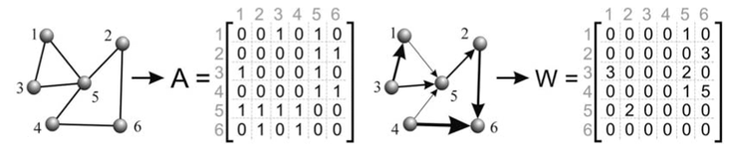
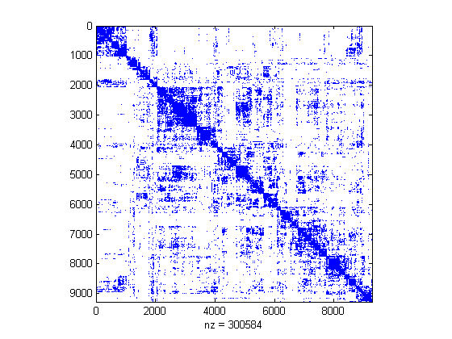
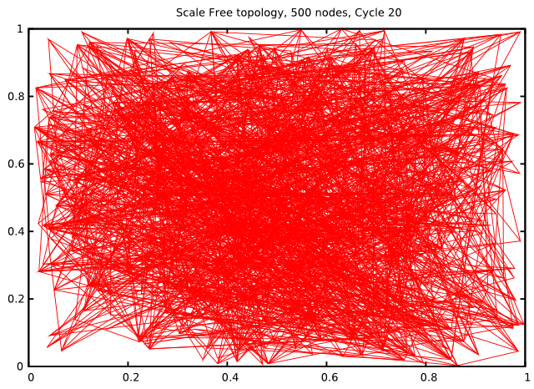
Adjacency Matrices
A more challenging example:

Slide 41
Visualization Techniques: Parallel Coordinates
Parallel Coordinates
Used to plot the attribute values of high-dimensional data
Instead of using perpendicular axes, use a set of parallel axes
The attribute values of each object are plotted as a point on each corresponding coordinate axis and the points are connected by a line
Thus, each object is represented as a line
Often, the lines representing a distinct class of objects group together, at least for some attributes
Ordering of attributes is important in seeing such groupings

Slide 42
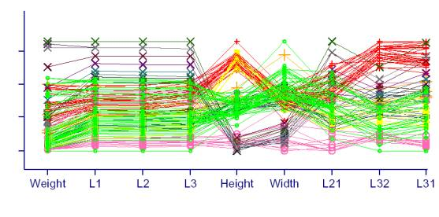
Parallel Coordinates

Slide 43
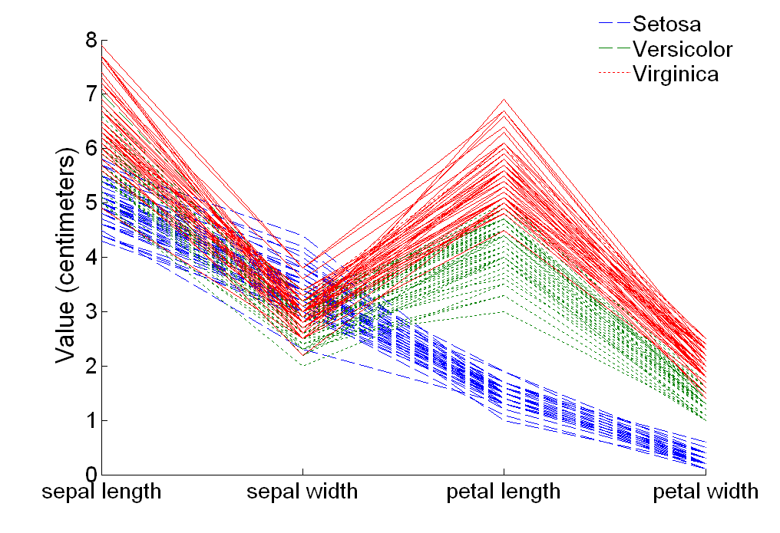
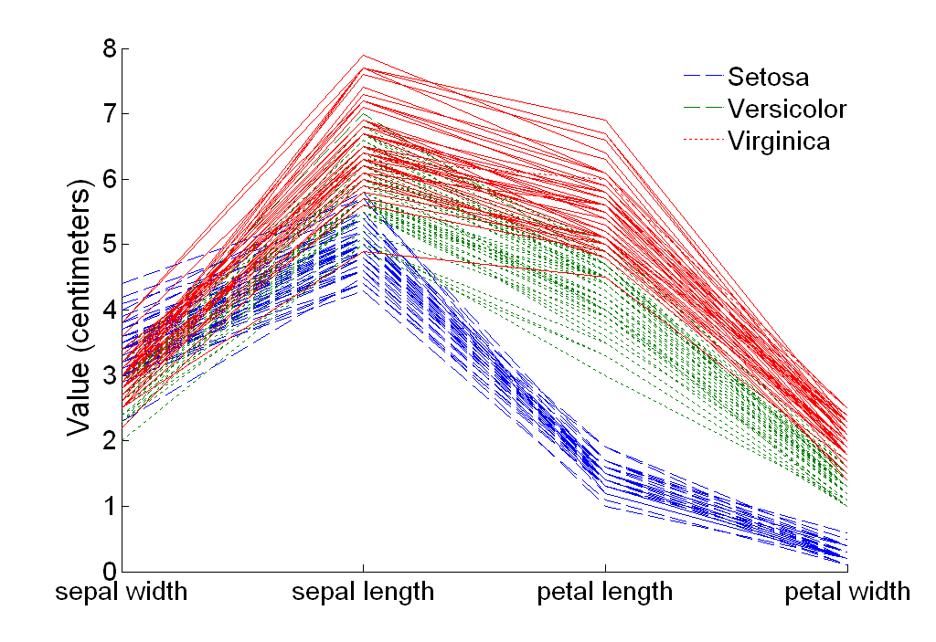
Parallel Coordinates Plots for Iris Data

Slide 44
Other Visualization Techniques
Star Plots
Similar approach to parallel coordinates, but axes radiate from a central point
The line connecting the values of an object is a polygon
Chernoff Faces
Approach created by Herman Chernoff
This approach associates each attribute with a characteristic of a face
The values of each attribute determine the appearance of the corresponding facial characteristic
Each object becomes a separate face
Relies on human’s ability to distinguish faces

Slide 45
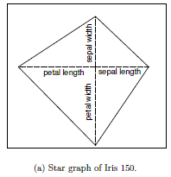
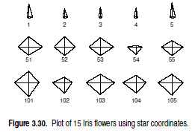
Star graphs for Iris Data

Slide 46
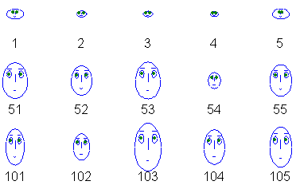
Chernoff Faces for Iris Data
Setosa
Versicolour
Virginica
Sepal length -> size of face, petal width -> shape of jaw, …

Slide 47
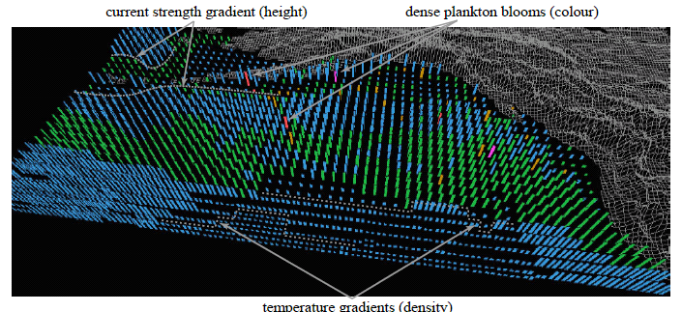
Multi-dimensional perception
Tailoring multi-dimensional representations to human perceptual strengths (Healey)
Notes:
Color, height, and density used to visualize open-ocean plankton density, ocean current strength, and sea surface temperature, respectively; low to high plankton densities represented with blue, green, brown, red, and purple, stronger currents represented with taller pexels, and warmer temperatures represented with denser pexels

Slide 48
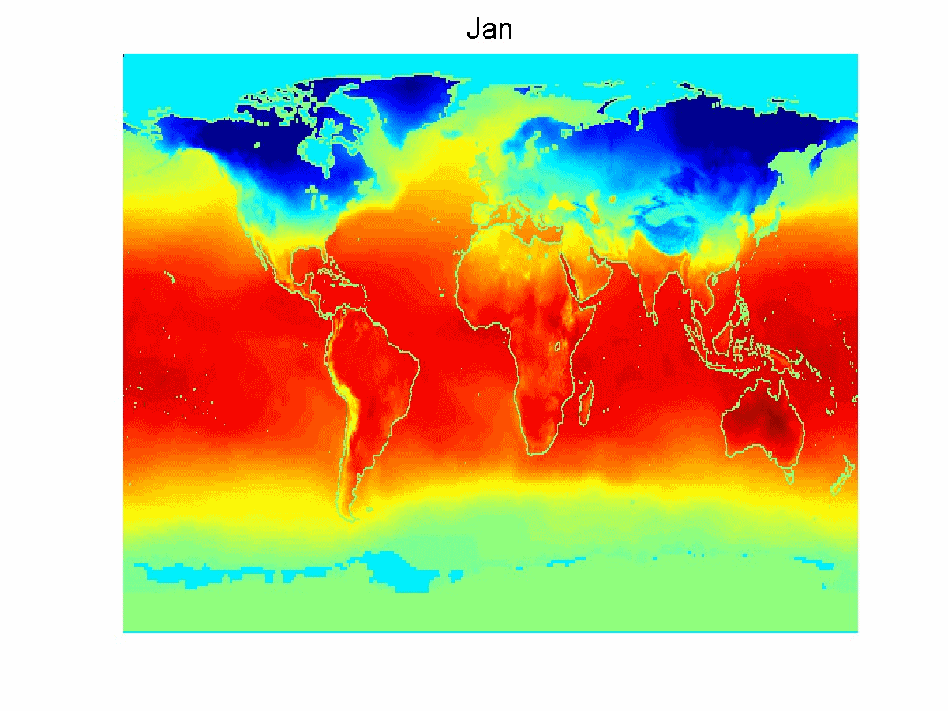
Animations

Slide 49
Fly-through/over Visualizations
Geographical information systems
Computer-aided architecture and design
Visiting the interior of a stellar simulation
Chromosome 11 Flyover
http://www.dnalc.org/resources/3d/chr11.html

Slide 50
Do’s and Don’ts
Burn’s ACCENT principles [D. A. Burn (1993), "Designing Effective Statistical Graphs".]
Apprehension
Can relations among variables be correctly perceived?
Clarity
Prominence should reflect importance
Consistency in depiction across displays
Efficiency in portrayal of relations
Necessity
Would some other portrayal be better?
Truthfulness to actual scaling

Slide 51
Edward Tufte: The Visual Display of Quantitative Information
Principles of Graphical Excellence
Graphical excellence is the well-designed presentation of interesting data - a matter of substance, of statistics, and of design. “If your statistics are boring then you’ve got the wrong numbers”
It consists of complex ideas communicated with clarity, precision, and efficiency.
Graphical excellence is that which gives to the viewer the greatest number of ideas in the shortest time with the least ink in the smallest space.
It is nearly always multivariate. “Escape Flatland!”
It requires telling the truth about the data.

Slide 52
Edward Tufte: The Visual Display of Quantitative Information
Principles of Graphical Integrity
The representation of numbers, as physically measured on the surface of the graphic itself, should be directly proportional to the numerical quantities represented.
Lie Factor = (size of effect shown in graphic) / (size of effect in data)
Clear, detailed, and thorough labeling should be used.
Show data variation, not design variation.
Graphics must not quote data out of context.
The number of information-carrying (variable) dimensions depicted should not exceed the number of dimensions in the data.

Slide 53
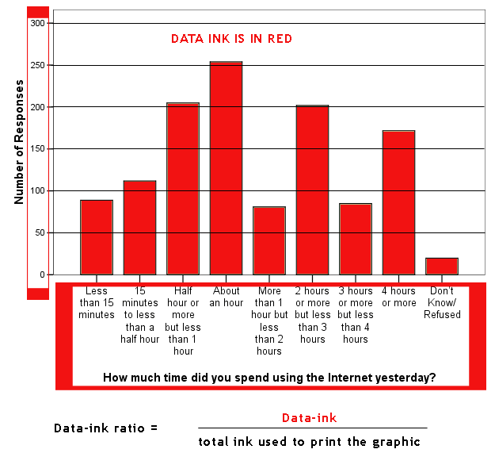
Edward Tufte: The Visual Display of Quantitative Information
Data-Ink
This is the non-erasable core of a graphic, the non-redundant ink arranged in response to variation in the numbers represented.
Data-ink ratio = (data ink) / (total ink used to print the graphic)

Slide 54
Edward Tufte: The Visual Display of Quantitative Information
Principles of data graphics
Above all else show the data.
Maximize the data-ink ratio.
Erase non-data-ink.
Erase redundant data-ink.
Revise and edit.

Slide 55
Edward Tufte: The Visual Display of Quantitative Information
Aesthetics and Technique in Design
Graphical elegance is often found in simplicity of design and complexity of data.
Tables are the best way to show numerical values, although the entries can also be arranged in semi-graphical form.
Tables also work well when the data presentation requires many localized comparisons.

Slide 56
Edward Tufte: The Visual Display of Quantitative Information
The Friendly Data Graphic
words are spelt out, elaborate encoding avoided
words run from left to right
little messages help explain data
labels are placed on the graphic itself; no legend is required
graphics attract viewer, provoke curiosity
colors, if used, are chosen so that the color-deficient and color-blind can make sense of the graphic
type is clear, precise, modest
type is upper-and-lower case, with serifs

Slide 57
Edward Tufte: The Visual Display of Quantitative Information
The Golden Rectangle
If the nature of the data suggests the shape of the graphic, follow that suggestion. Otherwise, move toward horizontal graphics about 50 percent wider than tall.

Slide 58
Chartjunk and Graphical Decoration
Don’t
Use overwhelming amount of ink to describe a few numbers
Print label information vertically
Use cross-hatching patterns that vibrate
Attempt to describe graphical elements with indecipherable graphical elements

Slide 59
Dumb Pie Chart
Distribution of Students by Age Group

Slide 60
Better: Vertical Histogram
Distribution of Students by Age Group
Percent

Slide 61
Better Yet…Horizontal Histogram
Age Group
Distribution of Students by Age Group

Slide 62
Graphs to Avoid
Pie charts
Star charts
3-D presentations of 2-D data

Slide 63
OLAP
On-Line Analytical Processing (OLAP) was proposed by E. F. Codd, the father of the relational database.
Relational databases put data into tables, while OLAP uses a multidimensional array representation.
Such representations of data previously existed in statistics and other fields
There are a number of data analysis and data exploration operations that are easier with such a data representation.

Slide 64
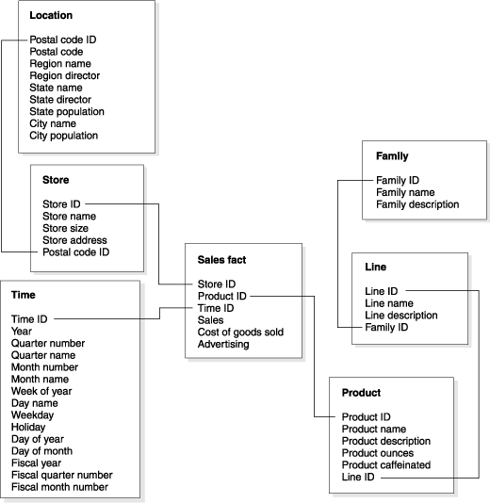
Fact Table and Dimension Tables

Slide 65
Navigation using data cubes
Date
Total annual sales
of TV in U.S.A.
1Qtr
2Qtr
3Qtr
4Qtr
sum
Product
TV
PC
U.S.A
VCR
sum
Canada
Country
Mexico
sum
All, All, All

Slide 66
Data cube navigation operations
Roll up (drill-up): summarize data
by climbing up hierarchy or by dimension reduction
Drill down (roll down): reverse of roll-up
from higher level summary to lower level summary or detailed data, or introducing new dimensions
Slice and dice:
project and select
Pivot (rotate):
reorient the cube, visualization, 3D to series of 2D planes.
Other operations
drill across: involving (across) more than one fact table
drill through: through the bottom level of the cube to its back-end relational tables (using SQL)

Slide 67
Creating a Multidimensional Array
Two key steps in converting tabular data into a multidimensional array.
First, identify which attributes are to be the dimensions and which attribute is to be the target attribute whose values appear as entries in the multidimensional array.
The attributes used as dimensions must have discrete values
The target value is typically a count or continuous value, e.g., the cost of an item
Can have no target variable at all except the count of objects that have the same set of attribute values
Second, find the value of each entry in the multidimensional array by summing the values (of the target attribute) or count of all objects that have the attribute values corresponding to that entry.

Slide 68
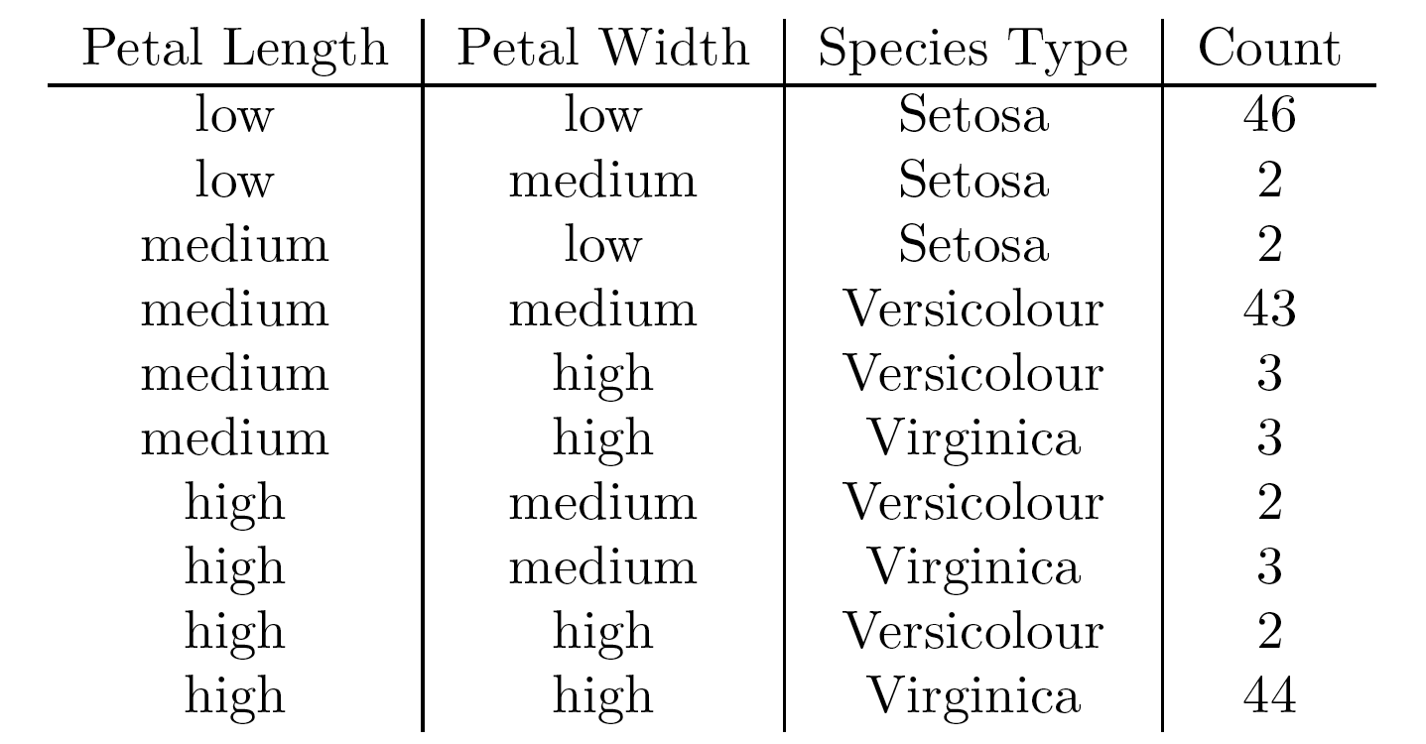
Example: Iris data
We show how the attributes, petal length, petal width, and species type can be converted to a multidimensional array
First, we discretized the petal width and length to have categorical values: low, medium, and high
We get the following table - note the count attribute

Slide 69
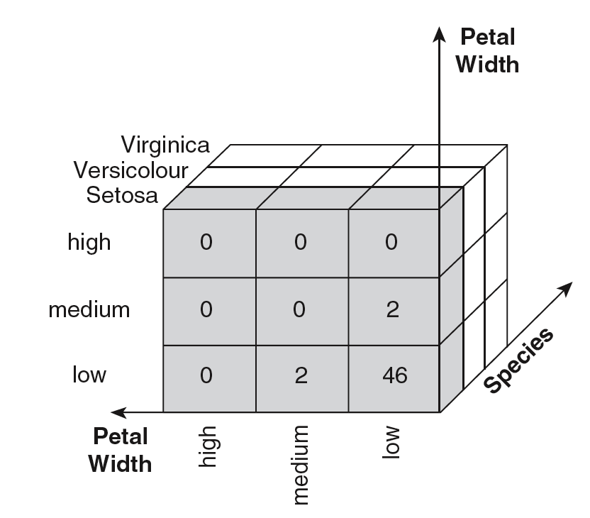
Example: Iris data (continued)
Each unique tuple of petal width, petal length, and species type identifies one element of the array.
This element is assigned the corresponding count value.
The figure illustrates the result.
All non-specified tuples are 0.

Slide 70
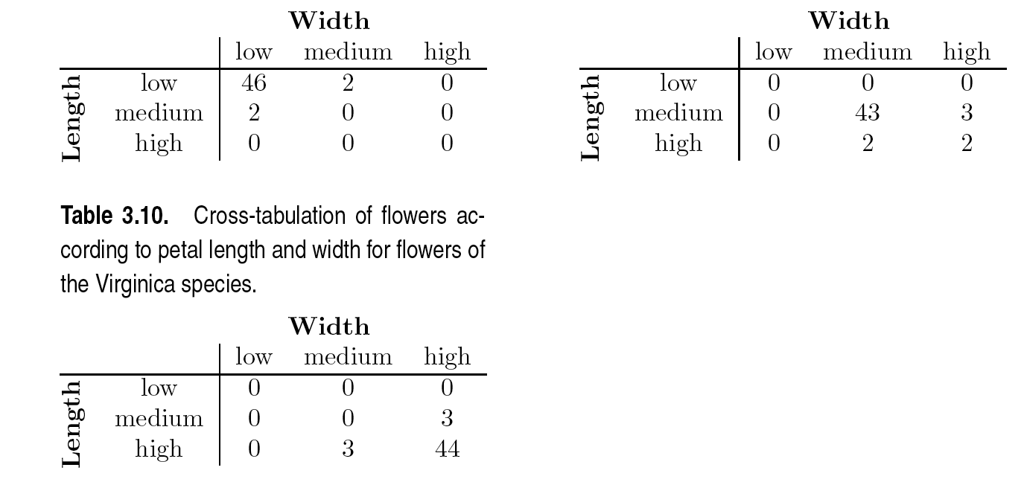
Example: Iris data (continued)
Slices of the multidimensional array are shown by the following cross-tabulations
What do these tables tell us?

Slide 71
OLAP Operations: Data Cube
The key operation of a OLAP is the formation of a data cube
A data cube is a multidimensional representation of data, together with all possible aggregates.
By all possible aggregates, we mean the aggregates that result by selecting a proper subset of the dimensions and summing over all remaining dimensions.
For example, if we choose the species type dimension of the Iris data and sum over all other dimensions, the result will be a one-dimensional entry with three entries, each of which gives the number of flowers of each type.

Slide 72
OLAP Operations: Slicing and Dicing
Slicing is selecting a group of cells from the entire multidimensional array by specifying a specific value for one or more dimensions.
Dicing involves selecting a subset of cells by specifying a range of attribute values.
This is equivalent to defining a subarray from the complete array.
In practice, both operations can also be accompanied by aggregation over some dimensions.

Slide 73
OLAP Operations: Roll-up and Drill-down
Attribute values often have a hierarchical structure.
Each date is associated with a year, month, and week.
A location is associated with a continent, country, state (province, etc.), and city.
Products can be divided into various categories, such as clothing, electronics, and furniture.
Note that these categories often nest and form a tree or lattice
A year contains months which contains day
A country contains a state which contains a city

Slide 74
OLAP Operations: Roll-up and Drill-down
This hierarchical structure gives rise to the roll-up and drill-down operations.
For sales data, we can aggregate (roll up) the sales across all the dates in a month.
Conversely, given a view of the data where the time dimension is broken into months, we could split the monthly sales totals (drill down) into daily sales totals.
Likewise, we can drill down or roll up on the location or product ID attributes.

Slide 75

Thank You!

